Slide 1
Cohort state-transition model variations in R
Using R for Decision Modeling in Health Technology Assessment
CE16
NIHES Erasmus Medical Center Rotterdam
February, 2020

Slide 2
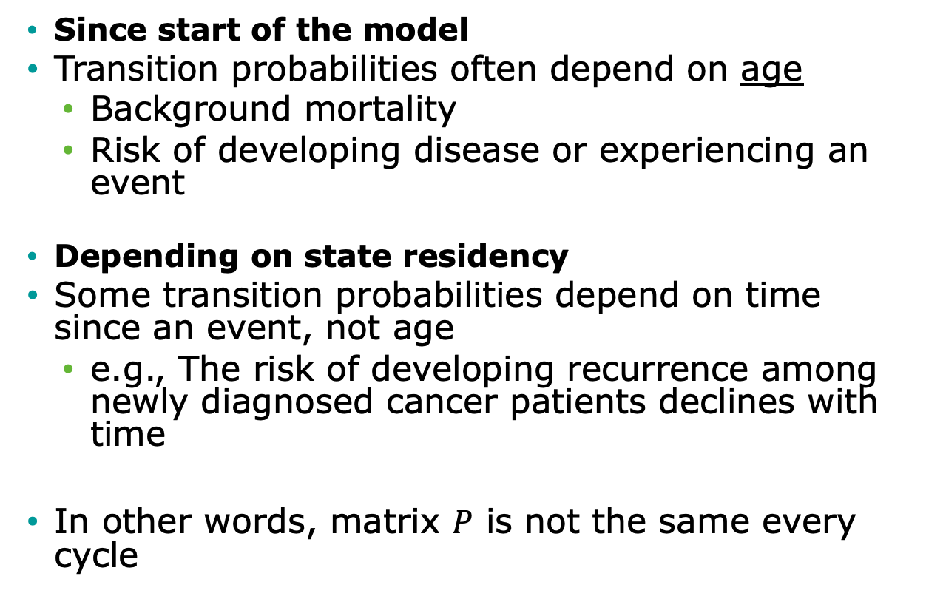
Time-dependency
Since start of the model
Transition probabilities often depend on age
Background mortality
Risk of developing disease or experiencing an event
Depending on state residency
Some transition probabilities depend on time since an event, not age
e.g., The risk of developing recurrence among newly diagnosed cancer patients declines with time
In other words, matrix $P$ is not the same every cycle

Slide 3
Time dependency since start of the model

Slide 4
Time-dependency since model start
Transition probabilities often depend on time since model start
Background mortality
Risk of developing disease or experiencing an event
In other words, matrix P is not the same every cycle
Replace matrix P with matrices P_{t}, where t is time since model start

Slide 5
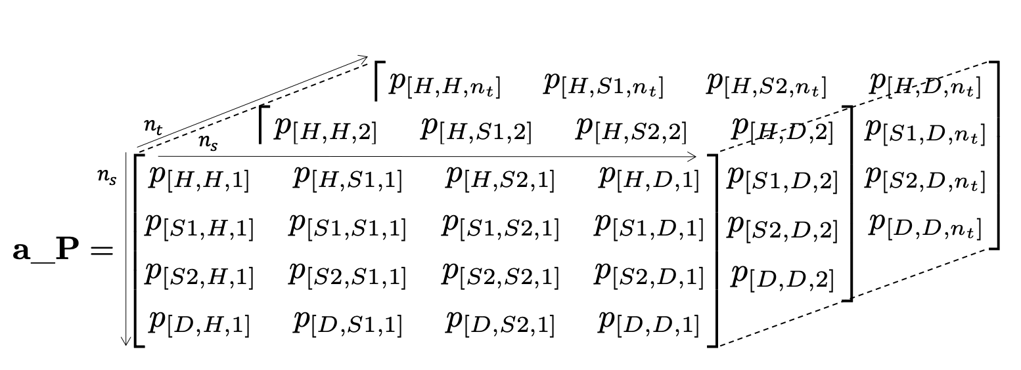
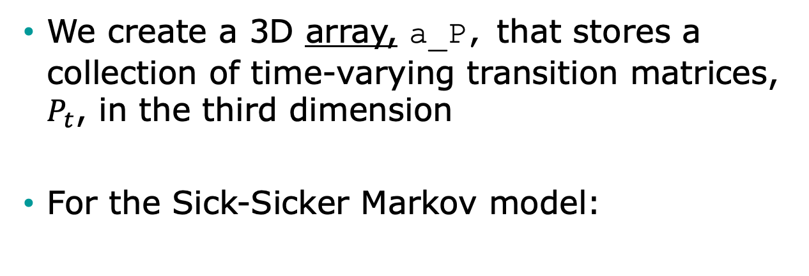
Time-varying probabilities in R
We create a 3D array, a_P, that stores a collection of time-varying transition matrices, $P_{t}$, in the third dimension
For the Sick-Sicker Markov model:

Slide 6
R Session –
3 state example

Slide 7
Time-dependent based on state residence

Slide 8
Other Types of Dependence
“Memoryless” property of Markov models is a BIG assumption
Transition probabilities only depend on the current state and not on past states
Many transition probabilities depend on model history, not time since model start
Risk of myocardial infarction (MI) greater for persons with prior MI
Effectiveness of a drug used as first-line therapy may be better than if used as second-line therapy

Slide 9
When history matters, create more states…
Healthy – Sick - Dead:
Once recovered, the risk of getting sick again or dying increases
Healthy (H)
Sick (S)
Dead (D)
Healthy (H)
Sick (S1)
Recovered (R)
Dead (D)
Healthy – Sick – Recovered - Dead

Slide 10

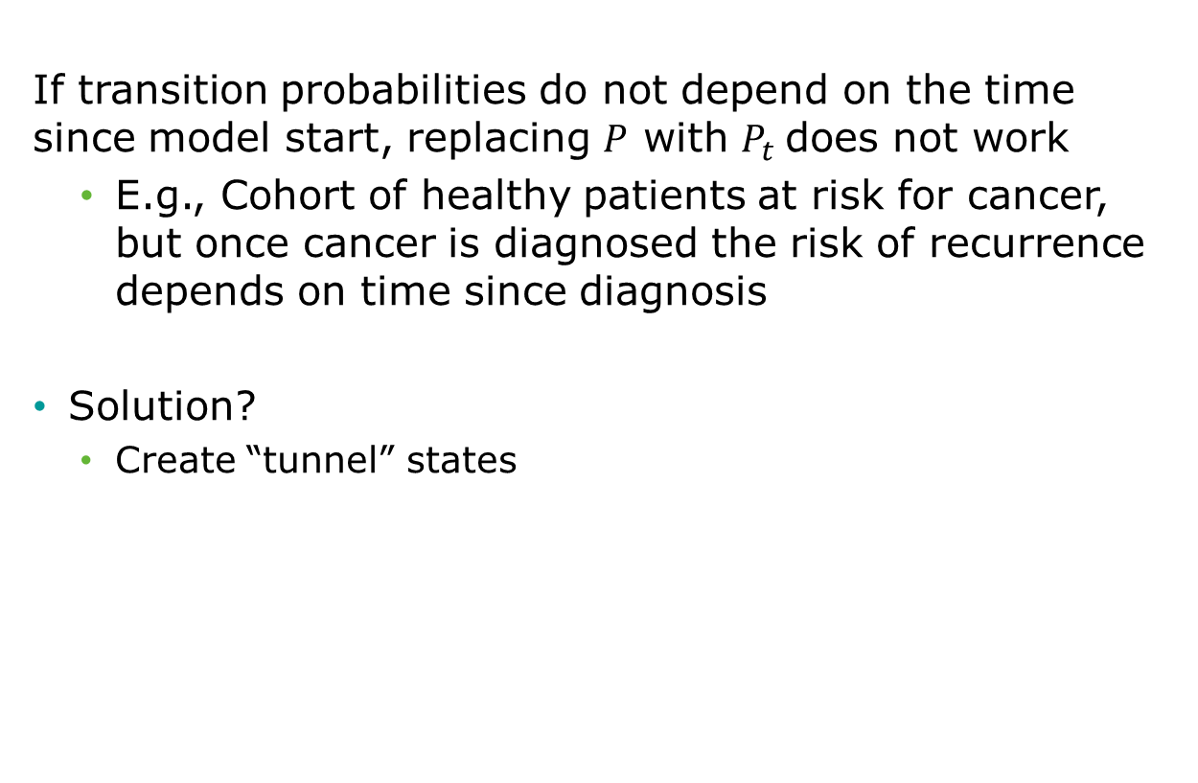
Tunnel states
If transition probabilities do not depend on the time since model start, replacing $P$ with $P_{t}$does not work
E.g., Cohort of healthy patients at risk for cancer, but once cancer is diagnosed the risk of recurrence depends on time since diagnosis
Solution?
Create “tunnel” states

Slide 11
State Time
f(model time)
f(state time)
Healthy
Cancer
Recur
Dead
Tunnel state

Slide 12
Tunnel States
p_Recur₁
Cancer 1
p_Recur₂
Cancer 2
p_Recur₃
Cancer 3
Recur
p_Recur₄
Cancer 4
p_Recur_{n}
Cancer n
Transitions to Dead also allowed.

Slide 13
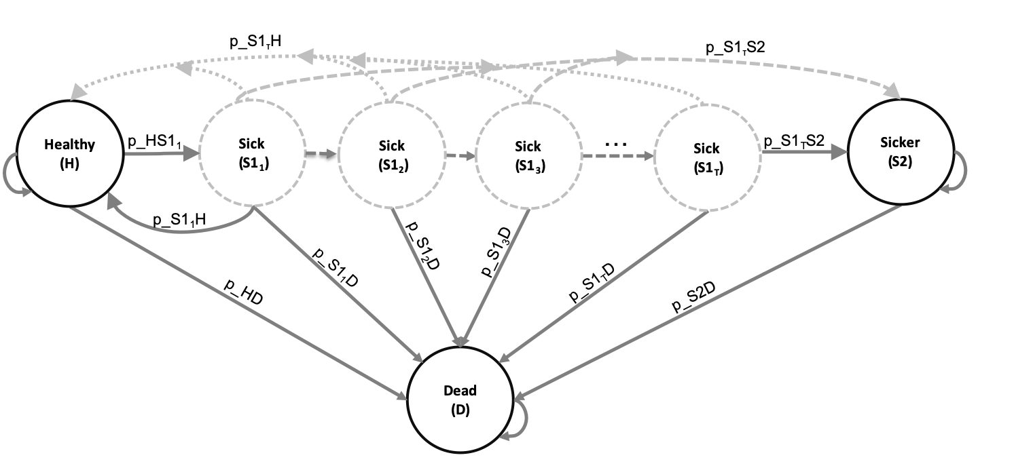
Time-dependent probabilities
Expand the states of the 3D array by the number of cycles considered in the time-dependency variable(s)
For the Sick-Sicker Markov model:

Slide 14
R Session

Slide 15
R Excercise

